Slide 1
Fasteners
Aerospace Manufacturing Core Study Guide
“AMCSG-202”
Tools & Processes

Slide 2
Fasteners

Slide 3
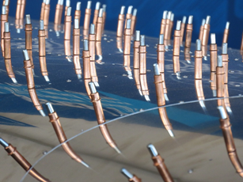
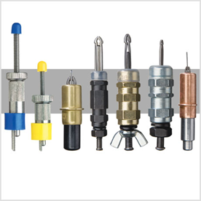
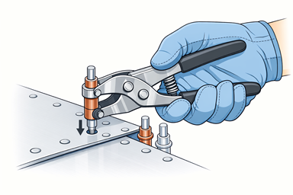
Cleco Temporary Fasteners
Text from Google AI
They hold materials during drilling & assembly
Types: pin, wing nut, nut-power, nut-less-power
Pin Cleco’s are installed with Cleco pliers
Wing nut Clecos by hand
Power Clecos by power tool
(CC4) Wikimedia Commons, 2015
(Ad) Pan American Tool Corp, 2026
ChatGPT / Matt Pierce, 2026
Notes:
Image Credits:
Google “Cleco fasteners” = (CC4) - https://commons.wikimedia.org/wiki/File:Cleko.jpg
Pan American Tool Corp = (Ad) - https://www.panamericantool.com/cleco-fasteners.html?srsltid=AfmBOopSK4AwtAP1zROrgsU2a5QdbdzeT_PqdszlTBGC_92gi_Lq8wEK
Image of hand installing fastener: ChatGPT: “picture using cleco pliers to place a cleco clamp on aircraft surface” + “make it into a single photo with gloved hand, training-manual style”

Slide 4
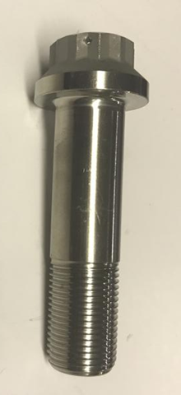
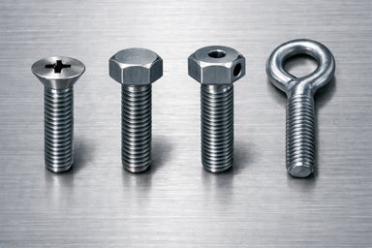
Bolts
Threaded fasteners are used for high strength
Components:
Types:
Flush Head
Hex Head
Drilled Head
Eyebolt
Head
Grip
Shank
Thread
ChatGPT / Matt Pierce, 2026
(Ad) SurplusMan.com, 2026
Diameter
Notes:
Image Credits:
Public domain image of “BACB30Ie12hu27” Boeing Aviation Grade bolt from surplusman.com: https://surplusman.com/item/bacb30le12hu27-boeing-aviation-grade-bolts/9693/
ChatGPT for bolt head types: “make a picture show several bolt types: flush head, protruding hex head, protruding drilled head, and eyebolt. Remove text labels.”

Slide 5
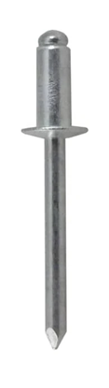
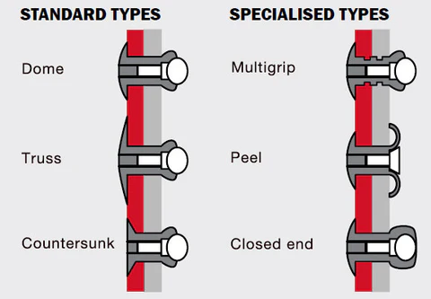
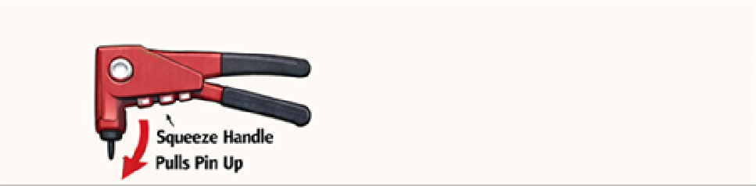
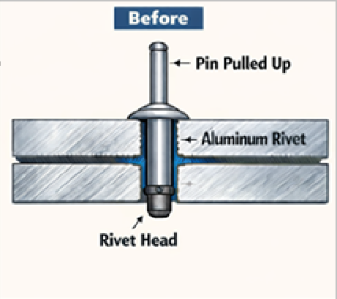
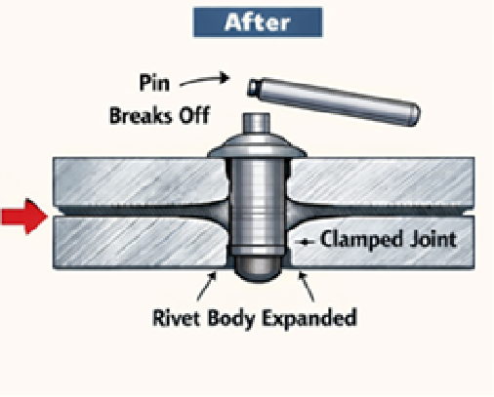
Rivets
Lighter than a bolt
Permanent
Pin Head
Body
Setting Head
ChatGPT / Matt Pierce, 2026
Pin/Mandrel
(Ad) Fisheries Supply, 2026
ChatGPT / Matt Pierce, 2026
Notes:
Image Credits:
Rivet Picture: From Fisheries Supply (sales website): https://encrypted-tbn3.gstatic.com/shopping?q=tbn:ANd9GcRURf0_XjySokKAN7xOMzD0x5XJtuEGAinThvon0nbvy_u4zXJ2o5RO4dk1SZXg1kgJp1Ixcqc_qJO_bzTu_m8W8mOs4CVh-BBIwz4xJ1uek2RheRYr1SrS
Rivet Process Diagram: ChatGPT: “make a picture showing how a rivet gun works”
Rivet Types Picture: ChatGPT: “make a diagram showing how a simple aluminum rivet gun works. Show cross section of two pieces of aluminum. Rivet head on the lower side of two pieces. Rivet body in hole between the two pieces of aluminum. Rivet pin/mandrel above the two pieces. simple red hand held rivet gun attached at the top of the rivet pin/mandrel. show how the rivet pin/mandrel will snap off once the river gun is squeezed.” + “remove labels "upper aluminum piece", "lower aluminum piece". Rename "mandrel" to "pin". Use only one arrow at "rivet body expanded". Only use one label (not two) for "Mandrel breaks off". Remove the yellow flash callout for "Mandrel Snaps Off!" Remove title "How a rivet gun works“ + “remove label "Lower Aluminum Piece". Make the broken off "Pin" longer in the after section, and make it horizontal.”

Slide 6
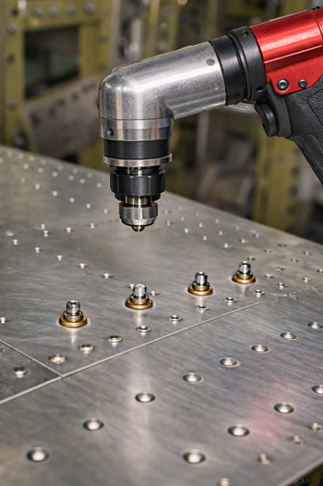
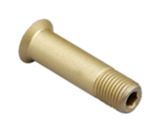

Hi-Lok Fasteners
Lighter than a bolt
Stronger than a rivet
Best of both
Head
Pin
Shank
Hex Socket (Allen Wrench)
Internal Threads
Collar
Internal Self-Locking Feature
(Ad) Howmet Aerospace, 2026
Break-off/Wrenching Head
ChatGPT / Matt Pierce, 2026
Notes:
Image Credits:
Sample Hi-Loks (Veri-Lite brand) for sale on “Howmet Aerospace” site: https://www.google.com/imgres?q=hi-lok%20fastener&imgurl=https%3A%2F%2Fwww.howmet.com%2Fwp-content%2Fuploads%2Fsites%2F3%2F2023%2F05%2FVeri-lite_1.png%3Fw%3D1024&imgrefurl=https%3A%2F%2Fwww.howmet.com%2Fproducts%2Faerospace%2Fpin-systems%2Fveri-lite-pin-fastening-system%2F&docid=7lnd3y8wNJspLM&tbnid=QHe65QBP0_EoLM&vet=12ahUKEwiDyPLQxr6SAxXFEDQIHW5uH-UQM3oECBMQAA..i&w=1023&h=456&hcb=2&ved=2ahUKEwiDyPLQxr6SAxXFEDQIHW5uH-UQM3oECBMQAA
Installation picture = ChatGPT = “make a picture showing installation of hi-lok fasteners onto aircraft surface using a universal tool pneumatic tool“ + “remove the cleco fasteners. show the hi-lok fasteners half-way in the hole.“ + “make the pneumatic tool straight. zoom in on the hi-lok fastener after installation with the tool head removed a few inches”

Slide 7
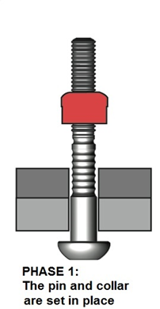
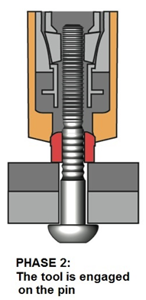
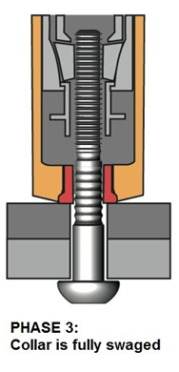
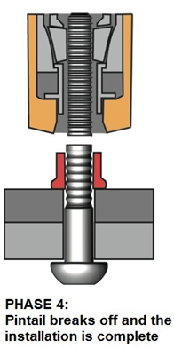
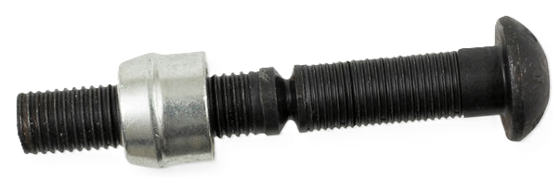
Lockbolt Fasteners
Stronger than a bolt & nut
Like a rivet
Head
Shank
Locking Grooves
Breakneck Groove
Pintail with
Pulling Grooves
ChatGPT / Matt Pierce, 2026
(Ad) Industry Plaza Sales, 2026
Locking Collar
Notes:
Image Credits:
Lockbolt Picture: From Industry Plaza Sales website: https://www.industry-plaza.com/lockbolts-huck-c50l-p158808.html
Lockbolt Process Diagram: ChatGPT: “make a diagram showing how lockbolt fasteners work.” Took the third one from list. First two sets of diagrams not as good.

Slide 8
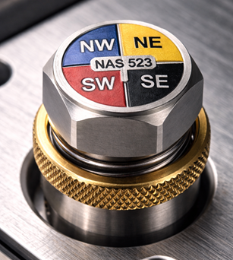
“NAS 523” Fastener Standards
Text from Google AI
NW Quadrant:
Engineering Code
Type/Material
NE Quadrant:
X=Diamer in 1/32”
N/F = Location Mfg Head ( Near or Far Side)
SW Quadrant:
D = Dimple
X = # Sheets to dimple
C = Countersink
SE Quadrant:
X = Rivet Length 1/16”
W = Spot Weld
ChatGPT / Matt Pierce, 2026
Notes:
Google AI: “fastener standards in aircraft manufacturing” for general information
Image Credits:
Image via ChatGPT: “make a photo of an aircraft manufacturing fastener with example nas 523 quandrant markings“ + “rename label "A1" to "NW". rename label "B2" to "NE". rename label "C3" to "SW". rename label "D4" to "SE".”

Slide 9
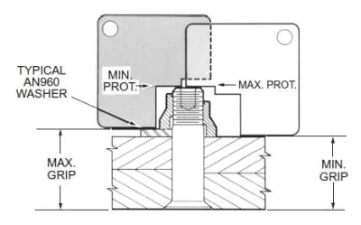
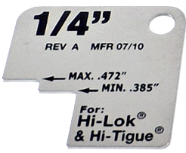
Inspecting Fasteners: Pin Protrusion (Height)
Text from ChatGPT
Inspecting “Pin Protrusion”
Gauge is thin metal card with two-step cutout
NoGo at Min Prot = PASS for too small
Go at Max Prot = PASS for too big
ChatGPT / Matt Pierce, 2026
ChatGPT / Matt Pierce, 2026
Notes:
Pin Protrusion Inspection: ChatGPT: “pin protrusion gage thin metal card 1/4“ generates 4 pictures. Using #2 (photo) and #3 (usage diagram).

Slide 10
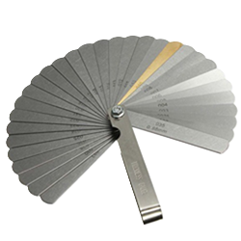
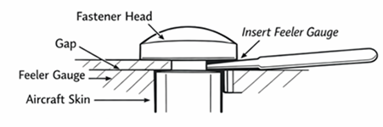



Inspecting Fasteners: “Gap” Size
Text from ChatGPT
Starting with smallest feeler gauge…
Try one by one until not slide freely in (goal = find which gauge not slide)
Gap tolerance is Summative
Compare NoGo size to engineering spec
(Ad) Ebay For Sale, 2026
ChatGPT / Matt Pierce, 2026
ChatGPT / Matt Pierce, 2026
Notes:
Image Credits:
Picture of Feeler Guage = Ebay for sale picture: “https://www.google.com/url?sa=i&url=https%3A%2F%2Fwww.ebay.com%2Fitm%2F263520840477&psig=AOvVaw0wcBatFQ1RXI_CCPuCQGWl&ust=1770350044353000&source=images&cd=vfe&opi=89978449&ved=0CBYQjRxqFwoTCJD085O2w5IDFQAAAAAdAAAAABAV”
Inspection Steps: ChatGPT: “diagram showing how to inspect fastener gap using feeler gauge. ”

Slide 11
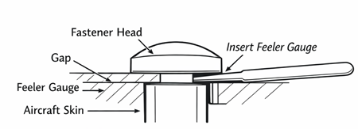

Inspecting Fasteners: 3-way Contact
Text from ChatGPT
Inspect Contact between Head, Collar, and Structure
Start from gap found, then test around fastener until hit at least one point of contact
ChatGPT / Matt Pierce, 2026
ChatGPT / Matt Pierce, 2026
Notes:
Same ChatGPT image as prior slide…just clipped out different pieces for this presentation

Slide 12
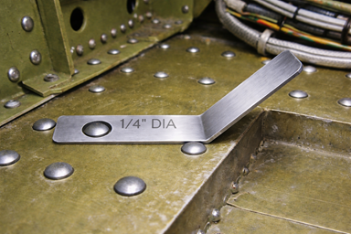
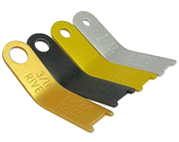
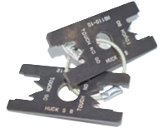
Inspecting Rivets: Diameter & Thickness
Text from ChatGPT
To inspect rivet heads:
Use a “spoon gauge”
…or an “H-gauge”
(Ad) Aircraft Spruce, 2026
ChatGPT / Matt Pierce, 2026
(Ad) VB Industrial Supply, 2026
Notes:
Image Credits:
Spoon guage picture for sale at Aircraft Spruce and Specialty: https://encrypted-tbn1.gstatic.com/shopping?q=tbn:ANd9GcRNGHpHs2lFiL8CEYaxgeLJ9edRjc35gAI9kAFvs-HLWRHFw3mFd8HZwz9t5i5axwtov4cXAn8YgN3j-vriDmbtvzWmc2mefg
H-Gauge picture for sale at VB Industrial Supply: https://encrypted-tbn3.gstatic.com/shopping?q=tbn:ANd9GcSOZm9C-LPr3tfdqzN0fNwIZVm9uctc5rZM0-b0XNONCDIdaaILsY45VJyn4pMXo3Hco9rRI6WiG3amUIu9GI_ktcjArFOv_0ITUeijP4dlGMMWgEP9ve9suv0D
Usage diagram: ChatGPT: “photo showing inspect rivet with a shop head rivet gauge set. Make it inside fuselage / wing bay realistic with several installed solid rivets. A shop head rivet gauge set (thin metal gauges with full circular cutout). A hand holding the gauge flat against the surface, sliding the correct gauge over the shop head The gauge clearly demonstrating: - 1/4" diameter requirement (shop just fits inside the gauge opening) Neutral lighting, realistic materials, no exaggerated colors“
+ “Make the gauge laying down flat around the rivet head. Make the gauge 3x longer with the hand further to the right and the hole further to the left” + “Lay the gauge down flat on the surface.”
+ “Make the hole smaller and the rivet head snuggly fit. Make the gauge narrower and longer. Make the gauge bend up 45 degrees from about its midpoint. Make the bent part 2x longer.”
H-Gauge:

Slide 13
Q&A

Slide 14
Practice Q&A’s (Q1-Q9)
Q5: How do you measure the grip of a threaded flush head fastener?
A: From the top of the head to top of threads
Q6: What are bolts comprised of?
A: Bolt and nut
Q7: Are bolts permanent fasteners?
A: No, they can be removed
Q8: What is the most common fastener type in aerospace manufacturing?
A: Rivets...look at the side of any plane :)
Q9: Are rivets permanent fasteners?
A: Yes
Q1: What is the most famous brand of temporary fasteners?
A: Cleco
Q2: Name of a common threaded fastener used for high strength?
A: Bolt
Q3: Name of the thickness two overlapping materials make when fastened together?
A: Grip height
Q4: How do you measure the grip of a threaded protruding head fastener?
A: From the bottom of head to top of threads

Slide 15
Practice Q&A’s (Q10-Q19)
Q15: What is an advantage of Lockbolts?
A: Stronger than bolt & nut. Locking collar will not rattle loose.
Q16: What are Lockbolts comprised of?
A: Bolt, breakaway pintail, and locking collar
Q17: Are Lockbolts permanent?
A: Yes, the locking collar is swaged online
Q18: What does NAS stand for (of NAS 523)?
A: National Aerospace Standard
Q19: What does the NW quadrant of NAS contain?
A: Fastener Type (engineering code)
Q10: What is an advantage to rivets?
A: Lighter than bolts
Q11: What are rivets comprised of?
A: Pin (or mandrel) and Body
Q12: Why is a Hi-Lok fastener the best of both a bolt and a rivet?
A: Lighter than a bolt, stronger than a rivets
Q13: What are Hi-Loks comprised of?
A: Pin and collar
Q14: Are Hi-Lok fasteners permanent?
A: Yes

Slide 16
Practice Q&A’s (Q20-Q28)
Q24: How do you use a feeler gauge?
A: Start with thinnest, go up until one not fit
Q25: Name of the distance across a bolt, side-to-side, thru the middle?
A: Diameter
Q26: Does the diameter of a fastener dictate its tolerance?
A: Yes. Larger diameter = larger tolerance
Q27: What is the most common cause of rivet defects?
A: Human error: improper technique or carelessness
Q28: Name both heads of a rivet?
A: 1. Manufactured head 2. Bucked (or driven) head
Q20: What does the SQ quadrant of NAS contain?
A: (D)imple or (C)ountersink or blank
Q21: What does the NE quadrant of NAS contain?
A: Diameter in 1/32ths of an inch; Near/Far side
Q22: What does the SE quadrant of NAS contain?
A: Length in 1/16ths of an inch; spot weld
Q23: What is the purpose of a feeler gauge?
A: Find first gap size to fail

Slide 17
Practice Q&A’s (Q29-Q32)
Q29: Using a feeler guage, what percent gap around a manufactured flush rivet head is acceptable?
A: No more than 40%
Q30: Installed fasteners must meet what guidelines?
A: Engineering Requirements
Q31: Name of the guage used to inspect diameter of a rivet head?
A: Spoon guage
Q32: What is the typical pressure (pounds per square inch) for aviation pneumatic tools?
A: 90 psi

Slide 18
Thank You
Matt Pierce - mpierce710006@gmail.com - linkedin.com/in/mpiercead576/
https://github.com/DataResearchLabs/study_guide_intro_aerospace_mfg

